Slide 1
A Sound Approach to Protect the Ocean
Mentor - Dominique Obaton
The Bloop – Kevin Kumar, Martha Omokore, Poonam Sanil

Slide 2
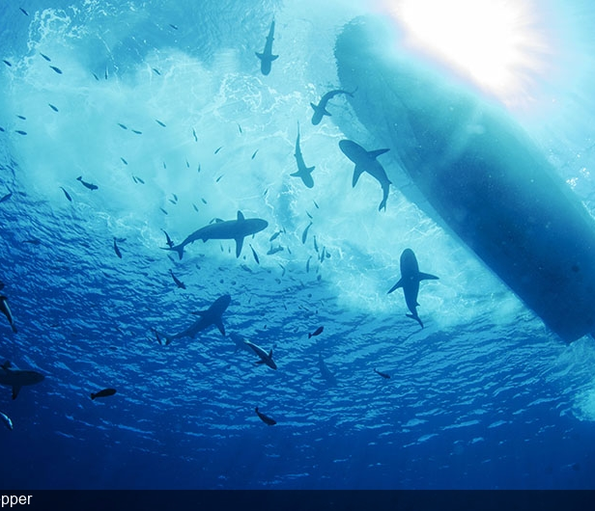
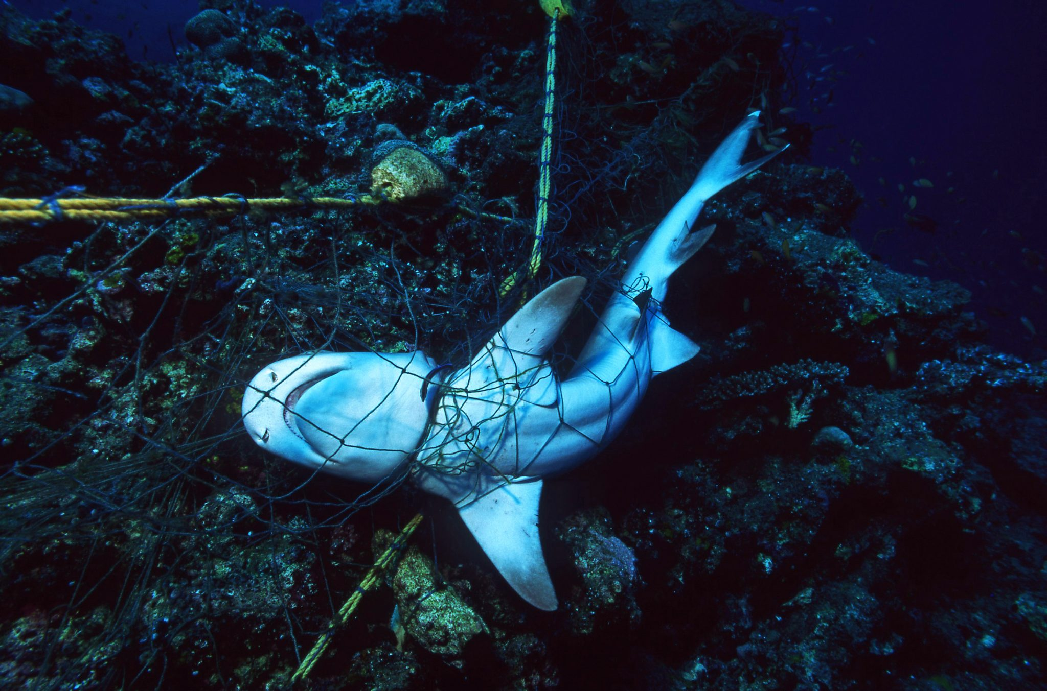
The Problem
Anthropogenic sounds poses a threat to marine life, and it can negatively impact the behavior, physiology and survival of marine animals, so necessary precautions must be taken before the noise pollution disrupts ocean life.
Abandoned, lost and discarded fishing gear is the biggest plastic polluter in ocean, entangling or suffocating marine life, sometimes causing slow death of marine animals. Animals that have taken millions of years to evolve, that are invaluable to all ecosystems, have and continue to vanish from places where they once flourished. It may become extinct if measures aren’t taken to protect it.
Understanding marine animal language has always been a challenge to researchers and scientists, however with the help of todays cutting-edge technology especially with the advancements in the field of Natural Language Processing, it is possible to decode the codas – the patterned click sequences used by sperm whales for communication.

Slide 3
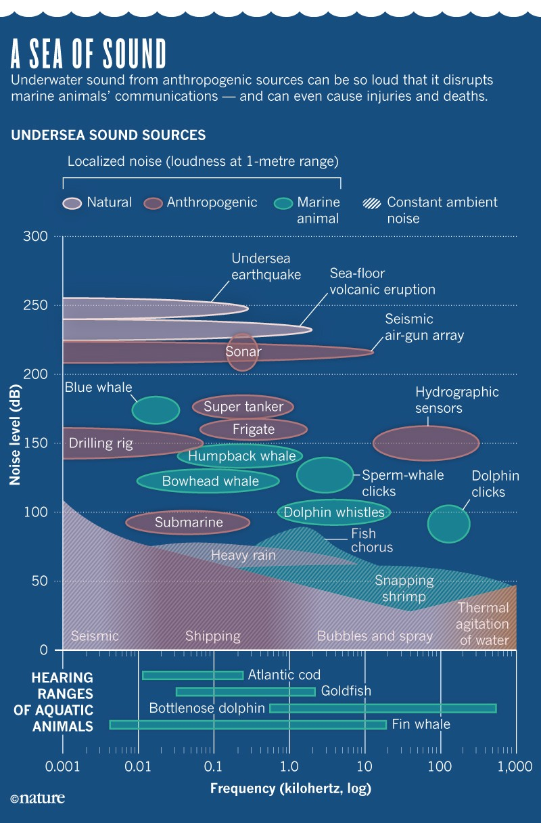
The Solution
Sound is extremely important to the survival of many marine animals especially the whale species and research is showing that there may be a link between ambient sounds (artificial sound) and the number of injured or beached whales.
For identifying marine animals and anthropogenic sounds, audio samples of 10 different classes (8 marine species + 2 anthropogenic sounds) are collected from various open-source sound databases (outside Blue Cloud), then multiple deep learning models are trained using Blue Cloud VRE, and lastly, the performances are compared to find out the best one.
For decoding the whale language, audio samples of two different species at different locations are collected and analyzed to understand the relationship and similarities between them.

Slide 4
Methodology
01
04
Data Collection
02
03
Result Analysis
NOAA Fisheries
Discovery of Sound in the Sea
Ocean Biodiversity Listening
Ocean Conservation Research
Watkins Marine Mammal Sound
Monterey Bay Aquarium Research Institute Freesound
Open Access Underwater Acoustics Data
Amongst the four models, the one that gives best performance will be selected
Feature Extraction
Model Training
Audio files are converted into spectrograms and audio specific features like mfcc, spectral centroid, zero crossing rate, chroma frequencies and spectral roll off are extracted
Convolutional Neural Network model was trained on spectrograms and three sequence based models (LSTM, Bidirectional LSTM & GRU) was trained on the audio specific features extracted from audio samples

Slide 5
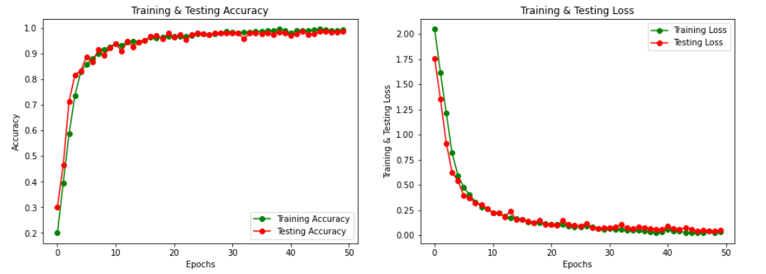
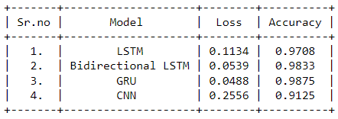
Results
Amongst the four deep learning models, GRU(Gated Recurrent Unit) was giving the best performance with very low loss and high accuracy.
Convolutional neural networks were finding it difficult to identify the classes because of the feature extraction technique and its kernels used to generate feature map.
Decoding whale language using unsupervised learning technique gave interesting results, the model was able to identify and group the two species (Sperm Whale & Humpback Whale) separately despite having different geographic locations.
That shows something that we did not know about whales – whales of the same species, just like people, might have different dialects based on the geographic location in which they live.

Slide 6
Project Foresight
For identifying marine animals and anthropogenic sounds, we are planning to collect more data samples (more marine species).
Combine audio samples with video and train a much more complex neural architecture and test its performance.
We wanted to connect to hydrophones and test the model using a hardware (NVIDIA Jetson) in real time.
For decoding whale language, we are planning to create a bot that could understand the relationships between the codas, for that we need to collect a greater number of codas samples.

Slide 7
Feedback
Blue Cloud Platform was easier to access, and there are huge volume of data samples available to do analysis on marine ecosystem.
Despite having huge volume of data, there were only few image-based data samples which could be increased in the future since computer vision technology is emerging.
It would also great if audio samples are also included, since it would help to do analysis and explore new things about the ocean and marine animals.

